Slide 1
Unit – 2 Python Data, Expressions and Statements
Jothiaruna N
SCSE, VIT Bhopal.

Slide 2
Python interpreter and interactive mode
Python interpreter
It reads and interprets Python scripts or commands by converting them into machine-readable instructions, so that the computer can execute.
It allows developers to interactively run Python code line by line (Interpreter takes single instruction as input).

Slide 3
Python interpreter and interactive mode
Compiler
To translate a program written in a high-level language into a low-level language all at once, in preparation for later execution.
Compiler takes entire program as input.

Slide 4
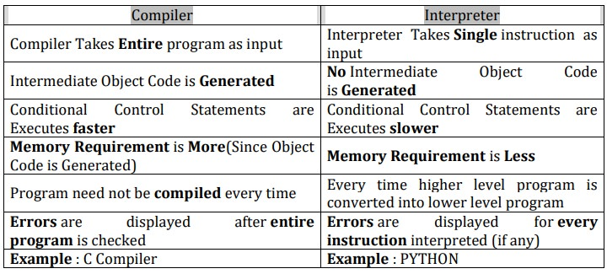
Python interpreter and interactive mode

Slide 5
Python interpreter and interactive mode
Python Interpreter is a program that reads and executes Python code. It uses 2 modes of Execution.
Interactive mode
Script mode

Slide 6
Interactive Mode
Interactive Mode, as the name suggests, allows us to interact with OS.
When we type Python statement, interpreter displays the result(s) immediately.
Advantages:
Python, in interactive mode, is good enough to learn, experiment or explore.
Working in interactive mode is convenient for beginners and for testing small pieces of code.

Slide 7
Interactive Mode
Drawback:
We cannot save the statements and have to retype all the statements once again to re-run them.
In interactive mode, you type Python programs and the interpreter displays the result:
>>>1 + 1
>>> 2
>>> print ('Hello, World!')
Hello, World!

Slide 8
Interactive Mode
The chevron, >>>, is the prompt the interpreter uses to indicate that it is ready for you to enter code.
If you type 1 + 1, the interpreter replies 2.
>>> print ('Hello, World!')
Hello, World!

Slide 9
Script Mode
In script mode, we type python program in a file and then use interpreter to execute the content of the file.
Scripts can be saved to disk for future use.
Save the code with filename.py and run the interpreter in script mode to execute the script.
Working in interactive mode is convenient for beginners
For testing small pieces of code, as we can test them immediately, interactive mode is good.
But for coding more than few lines, we should always save our code so that we may modify and reuse the code.

Slide 10
 | Interactive mode |  |  | Script mode
A way of using the Python interpreter by |  |  | A way of using the Python interpreter to
typing commands and expressions at the |  |  | read and execute statements in a script.
prompt.
Cant save and edit the code |  |  | Can save and edit the code
If we want to experiment with the code, |  |  | If we are very clear about the code, we can
we can use interactive mode. |  |  | use script mode.
we cannot save the statements for further |  |  | we can save the statements for further use
use and we have to retype |  |  | and we no need to retype
all the statements to re-run them. |  |  | all the statements to re-run them.
We can see the results immediately. |  |  | We cant see the code immediately.

Slide 11
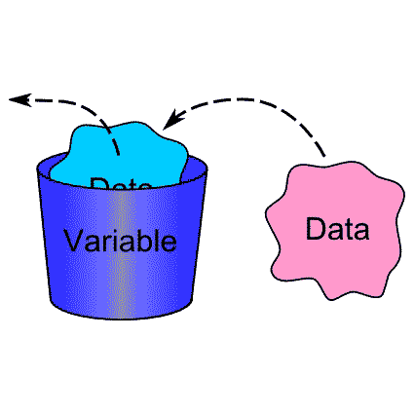
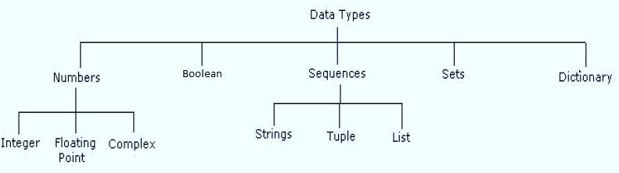
VALUES AND DATA TYPES
Value
Value can be any letter ,number or string.
EX, Values are 2, 42.0, and 'Hello, World!'. (These values belong to different datatypes.)
Data type
Every value in Python has a data type. It is a set of values, and the allowable operations on those values.

Slide 12
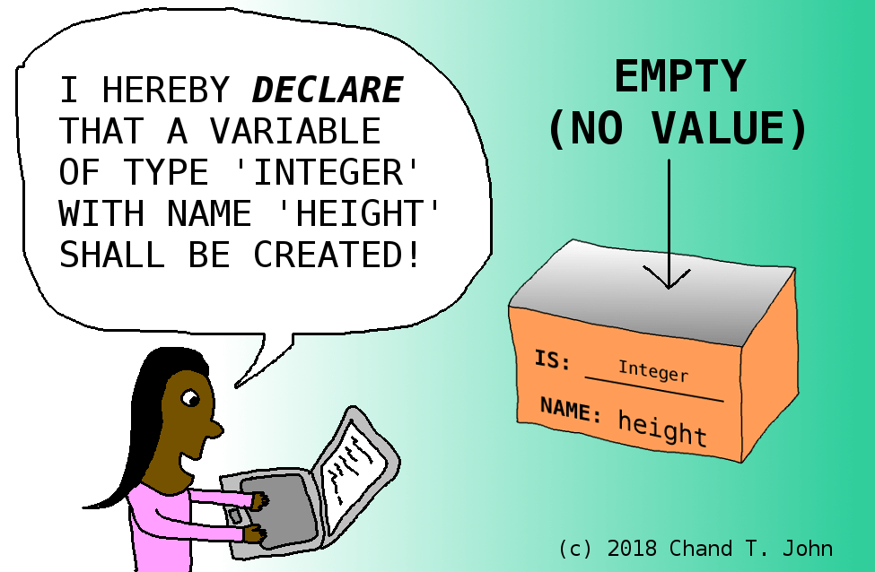
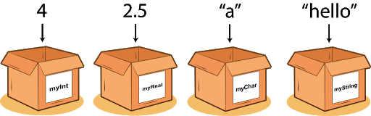
VALUES AND DATA TYPES

Slide 13
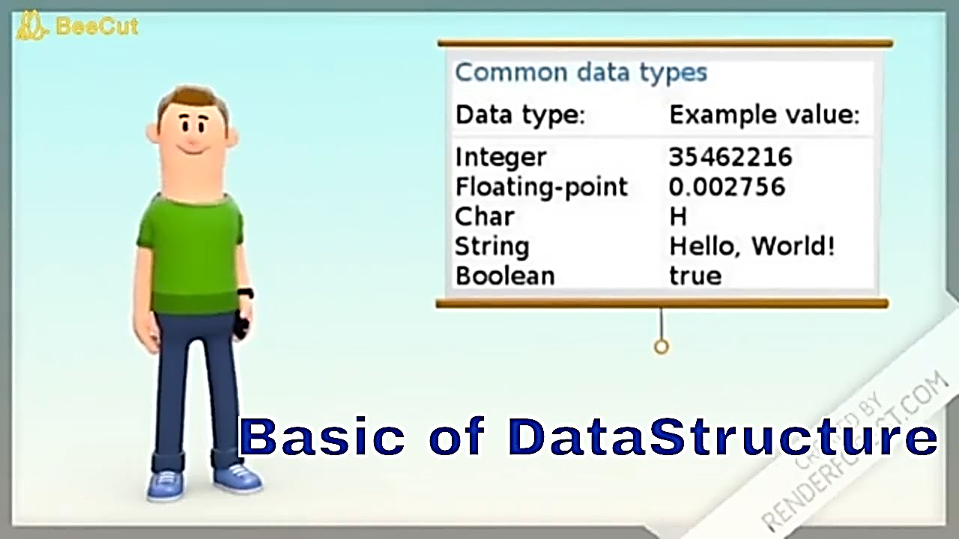
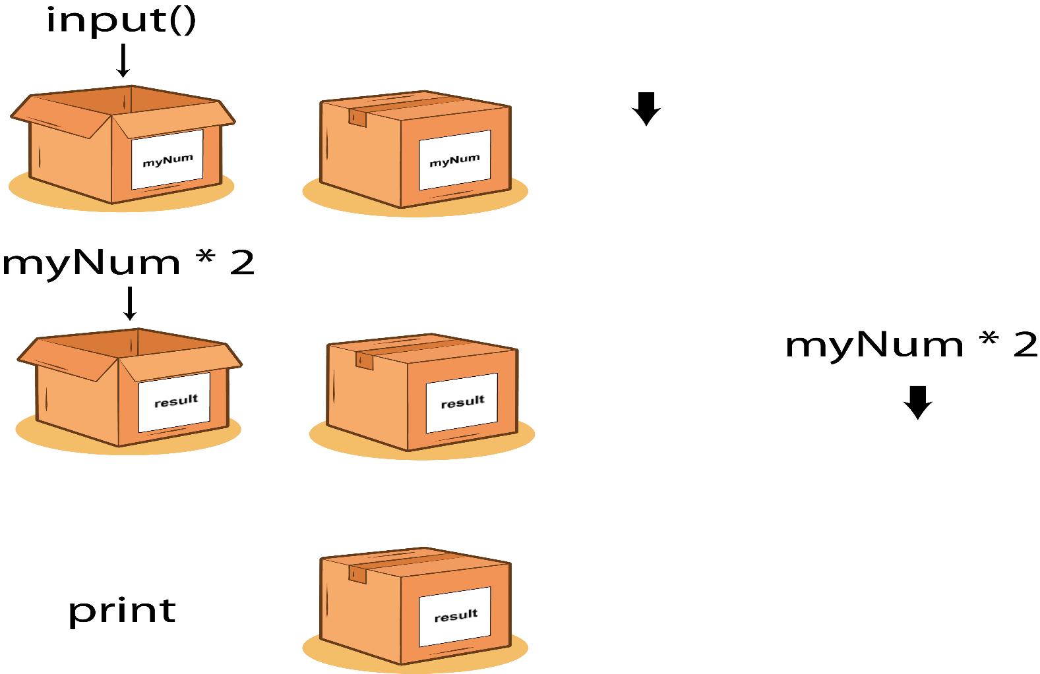
VALUES AND DATA TYPES

Slide 14
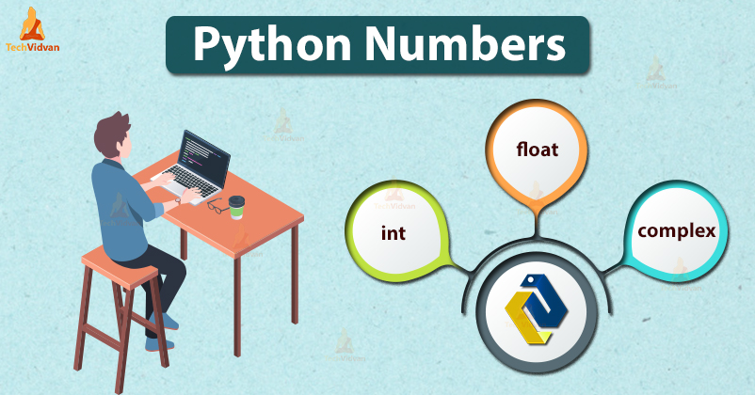
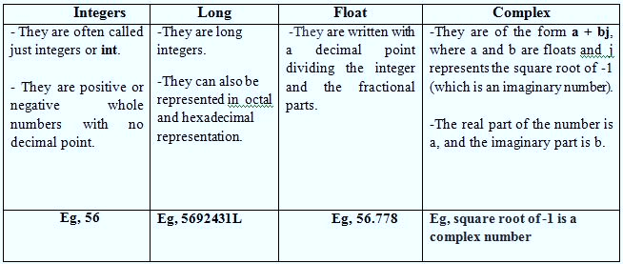
NUMBERS
Number data type stores Numerical Values.
This data type is immutable [i.e. values/items cannot be changed].
Python supports integers, floating point numbers and complex numbers. They are defined as,

Slide 15
SEQUENCE
A sequence is an ordered collection of items, indexed by positive integers.
It is a combination of mutable (value can be changed) and immutable (values cannot be changed) data types.
There are three types of sequence data type available in Python, they are
Strings
Lists
Tuples

Slide 16
STRINGS
A String in Python consists of a series or sequence of characters - letters, numbers, and special characters.
Strings are marked by quotes:
• single quotes (' '), Eg, 'This a string in single quotes'
double quotes (" "), Eg, "This a string in double quotes“
triple quotes (""“ """), Eg, This is a paragraph. It is made up of multiple lines and sentences."""
Individual character in a string is accessed using a subscript (index).
Characters can be accessed using indexing and slicing operations
Strings are immutable i.e. the contents of the string cannot be changed after it is created.

Slide 17
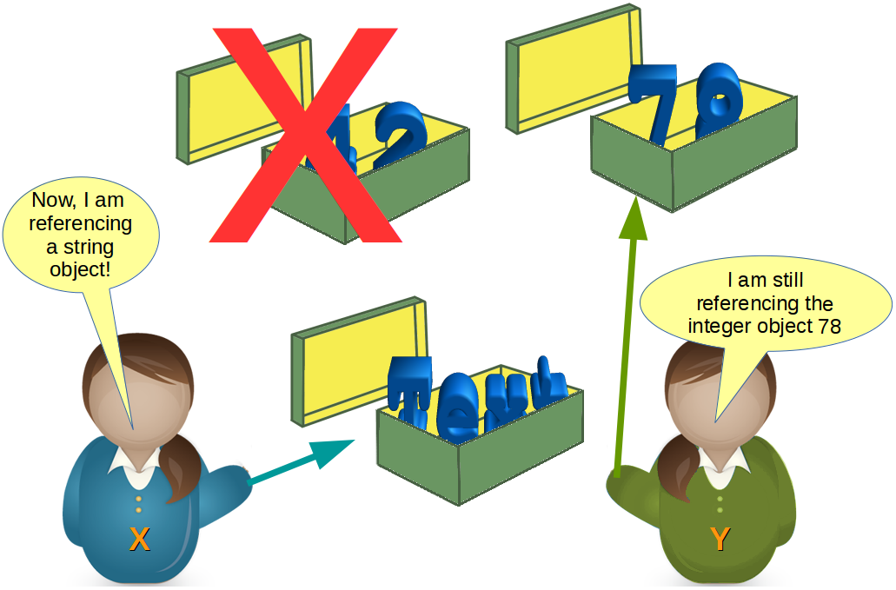
STRINGS
Strings and Operations
Indexing
Concatenation
Slicing
Repetition
Membership
Live Examples …….

Slide 18
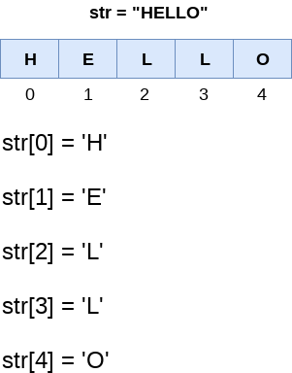

Slide 19
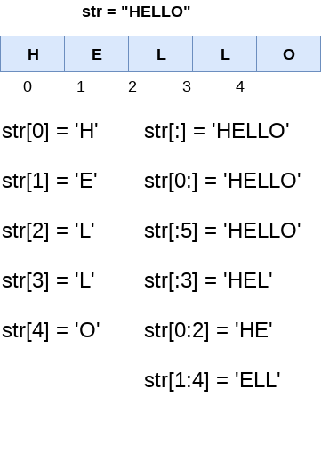

Slide 20
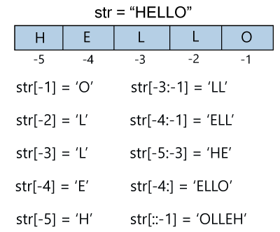

Slide 21
LISTS
A list in Python is used to store the sequence of various types of data.
L1 = ["John", 102, "USA"]
L2 = [1, 2, 3, 4, 5, 6]
The items in the list are separated with the comma (,) and enclosed with the square brackets [].
Python lists are mutable type it means that we can modify its element after it created.
However, Python consists of six data-types
They are capable to store the sequences.
But the most common and reliable type is the list.

Slide 22
print(type(L1))
print(type(L2))
<class ‘list’>

Slide 23
Characteristics of Lists
The lists are ordered.
a = [1,2,"Peter",4.50,"Ricky",5,6]
b = [1,2,5,"Peter",4.50,"Ricky",6]
a ==b This results in False. Why?
The element of the list can access by index.
The lists are the mutable type.
A list can store the number of various elements.

Slide 24
LISTS
Lists and Operations
Indexing
Concatenation
Slicing
Repetition
Membership
Updation-Deletion and Insertion
Live Examples …….

Slide 25
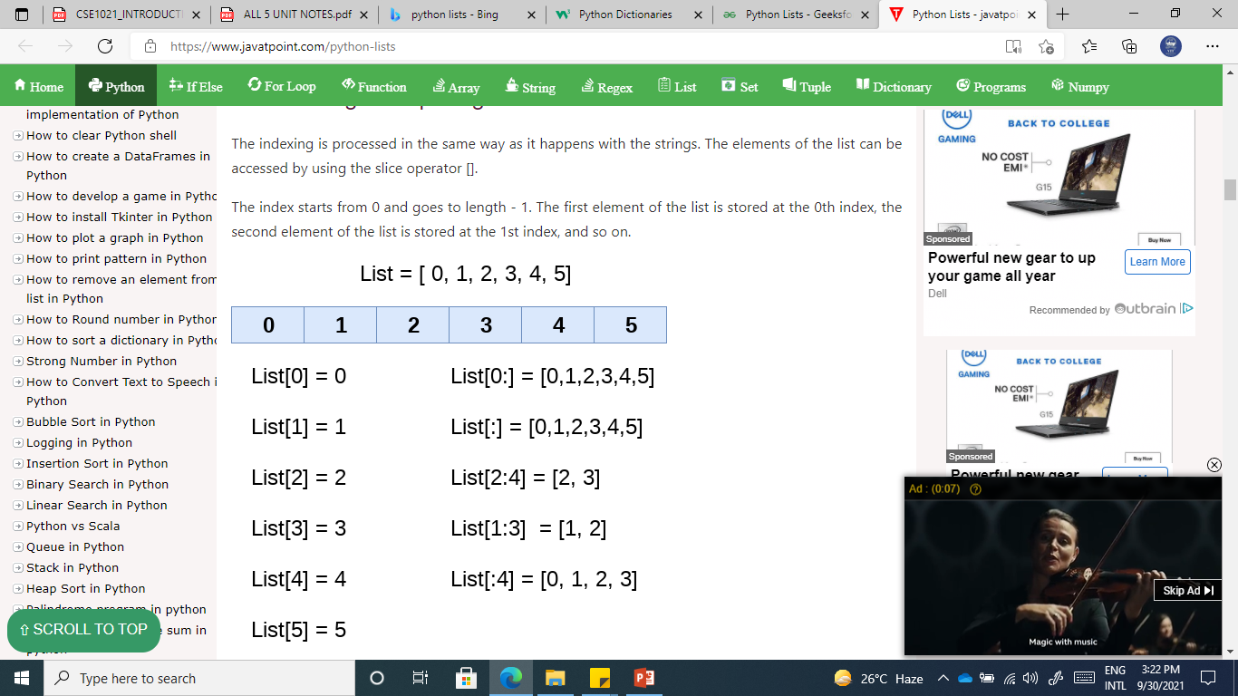

Slide 26
list_varible(start:stop:step)
The start denotes the starting index position of the list.
The stop denotes the last index position of the list.
The step is used to skip the nth element within a start:stop

Slide 27
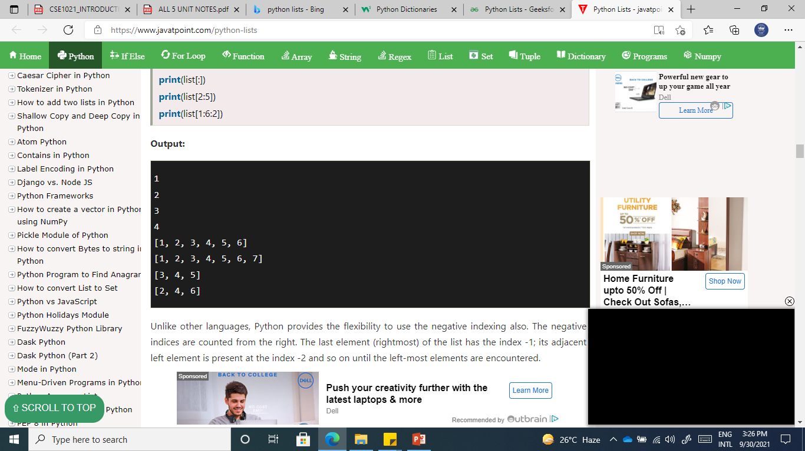
list = [1,2,3,4,5,6,7]
print(list[0])
print(list[1])
print(list[2])
print(list[3])
# Slicing the elements
print(list[0:6])
print(list[:])
print(list[2:5])
print(list[1:6:2])

Slide 28
Unlike other languages, Python provides the flexibility to use the negative indexing also.
The negative indices are counted from the right.
The last element (rightmost) of the list has the index -1;
its adjacent left element is present at the index -2 and so on until the left-most elements are encountered.

Slide 29
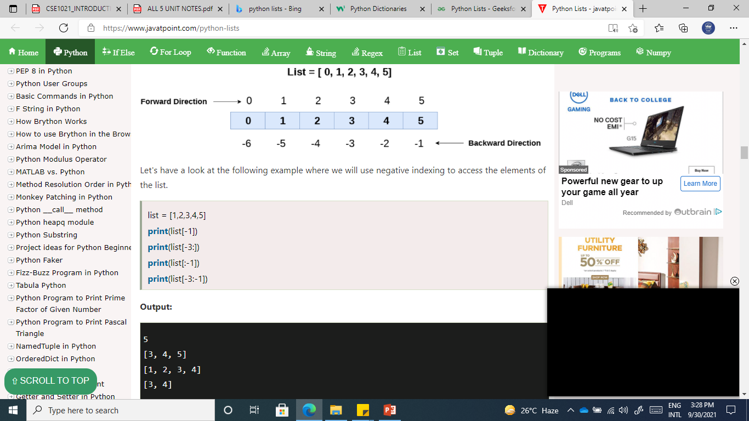

Slide 30
Updating List values
Lists are the most versatile data structures in Python since they are mutable, and their values can be updated by using the slice and assignment operator.
list = [1, 2, 3, 4, 5, 6]
print(list)
list[2] = 10
print(list)
list[1:3] = [89, 78]
print(list)
list[-1] = 25
print(list)
[1, 2, 3, 4, 5, 6]
[1, 2, 10, 4, 5, 6]
[1, 89, 78, 4, 5, 6]
[1, 89, 78, 4, 5, 25]

Slide 31
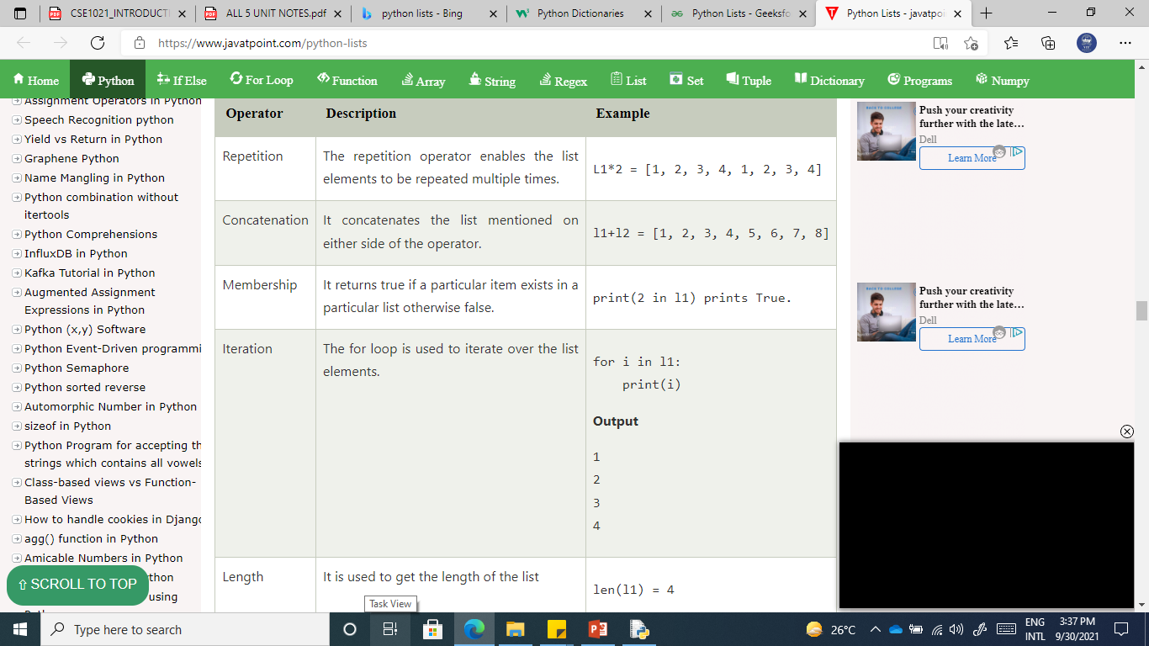
l1 = [1, 2, 3, 4] l2 = [5, 6, 7, 8]

Slide 32
TUPLES
A tuple is same as list, except that the set of elements is enclosed in parentheses instead of square brackets.
Tuple is an immutable list. i.e. once a tuple has been created, you can't add elements to a tuple or remove elements from the tuple.
Benefit of Tuple:
Tuples are faster than lists.
If the user wants to protect the data from accidental changes, tuple can be used.
Tuples can be used as keys in dictionaries, while lists can't.

Slide 33
TUPLES
Tuples and Operations
Indexing
Concatenation
Slicing
Repetition
Live Examples …….

Slide 34
T1 = (101, "Peter", 22)
T2 = ("Apple", "Banana", "Orange")
T3 = 10,20,30,40,50
print(type(T1))
print(type(T2))
print(type(T3))
<class 'tuple'>
<class 'tuple'>
<class 'tuple'>

Slide 35
Empty Tuple
T4 = ()
Creating a tuple with single element is slightly different. We will need to put comma after the element to declare the tuple.
tup1 = ("JavaTpoint")
print(type(tup1))
#Creating a tuple with single element
tup2 = ("JavaTpoint",)
print(type(tup2))
<class 'str'>
<class 'tuple'>

Slide 36
tuple1 = (10, 20, 30, 40, 50, 60)
print(tuple1)
count = 0
for i in tuple1:
print("tuple1[%d] = %d"%(count, i))
count = count+1
(10, 20, 30, 40, 50, 60)
tuple1[0] = 10
tuple1[1] = 20
tuple1[2] = 30
tuple1[3] = 40
tuple1[4] = 50
tuple1[5] = 60

Slide 37
tuple1 = tuple(input("Enter the tuple elements ..."))
print(tuple1)
count = 0
for i in tuple1:
print("tuple1[%d] = %s"%(count, i))
count = count+1
Enter the tuple elements ...
123456
('1', '2', '3', '4', '5', '6')
tuple1[0] = 1
tuple1[1] = 2
tuple1[2] = 3
tuple1[3] = 4
tuple1[4] = 5
tuple1[5] = 6

Slide 38
Tuple indexing and slicing
The indexing and slicing in the tuple are similar to lists. The indexing in the tuple starts from 0 and goes to length(tuple) - 1.
The items in the tuple can be accessed by using the index [] operator.
Python also allows us to use the colon operator to access multiple items in the tuple.

Slide 39
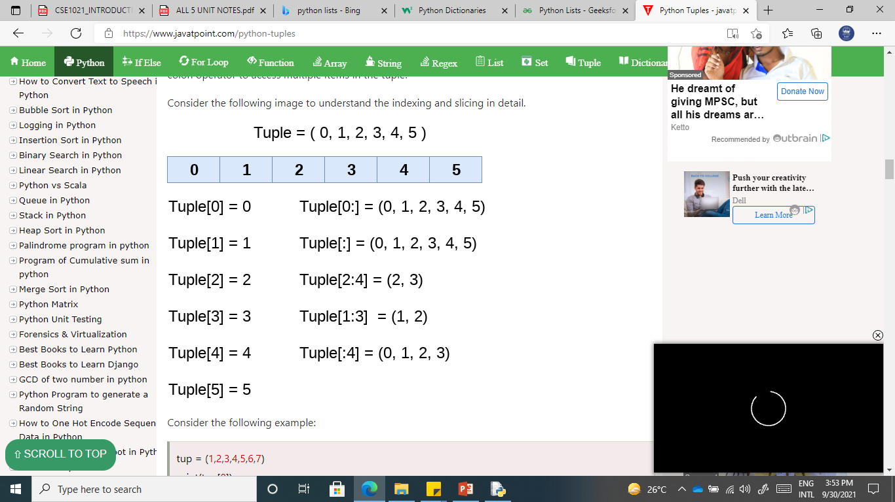

Slide 40
tuple = (1,2,3,4,5,6,7)
#element 1 to end
print(tuple[1:])
#element 0 to 3 element
print(tuple[:4])
#element 1 to 4 element
print(tuple[1:5])
# element 0 to 6 and take step of 2
print(tuple[0:6:2])
(2, 3, 4, 5, 6, 7)
(1, 2, 3, 4)
(1, 2, 3, 4)
(1, 3, 5)

Slide 41
tuple1 = (1, 2, 3, 4, 5)
print(tuple1[-1])
print(tuple1[-4])
print(tuple1[-3:-1])
print(tuple1[:-1])
print(tuple1[-2:])
5
2
(3, 4)
(1, 2, 3, 4)
(4, 5)

Slide 42
Deleting Tuple
Unlike lists, the tuple items cannot be deleted by using the del keyword as tuples are immutable.
To delete an entire tuple, we can use the del keyword with the tuple name
tuple1 = (1, 2, 3, 4, 5, 6)
print(tuple1)
del tuple1[0]
print(tuple1)
del tuple1
print(tuple1)
(1, 2, 3, 4, 5, 6)
Traceback (most recent call last):
File "tuple.py",
line 4, in <module> print(tuple1)
NameError: name 'tuple1' is not defined

Slide 43
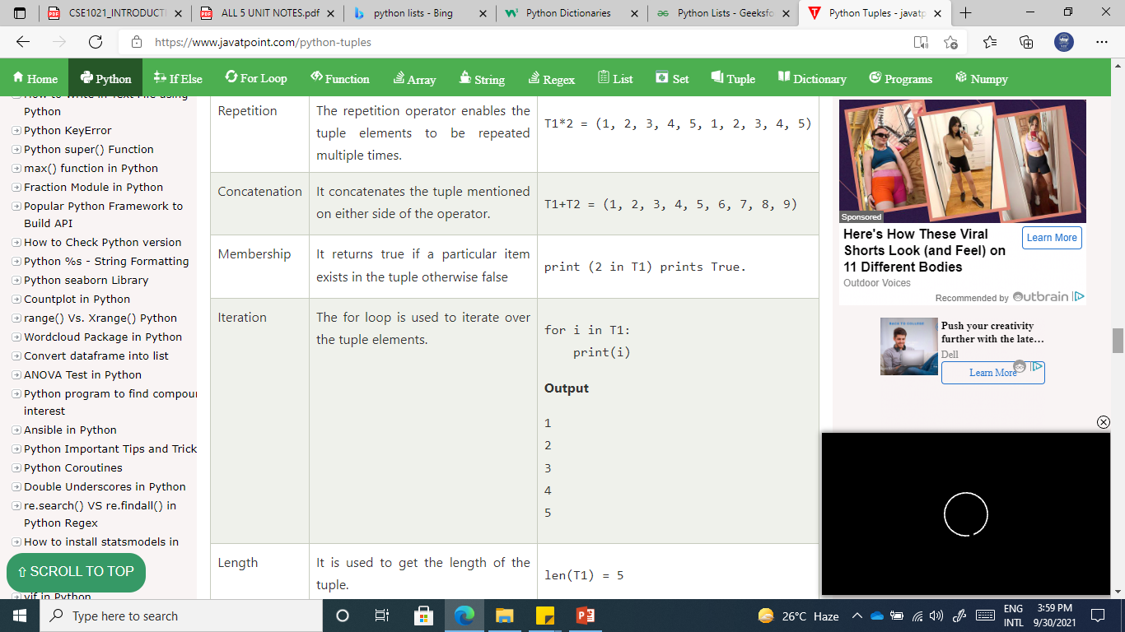
t = (1, 2, 3, 4, 5)
t1 = (6, 7, 8, 9)

Slide 44
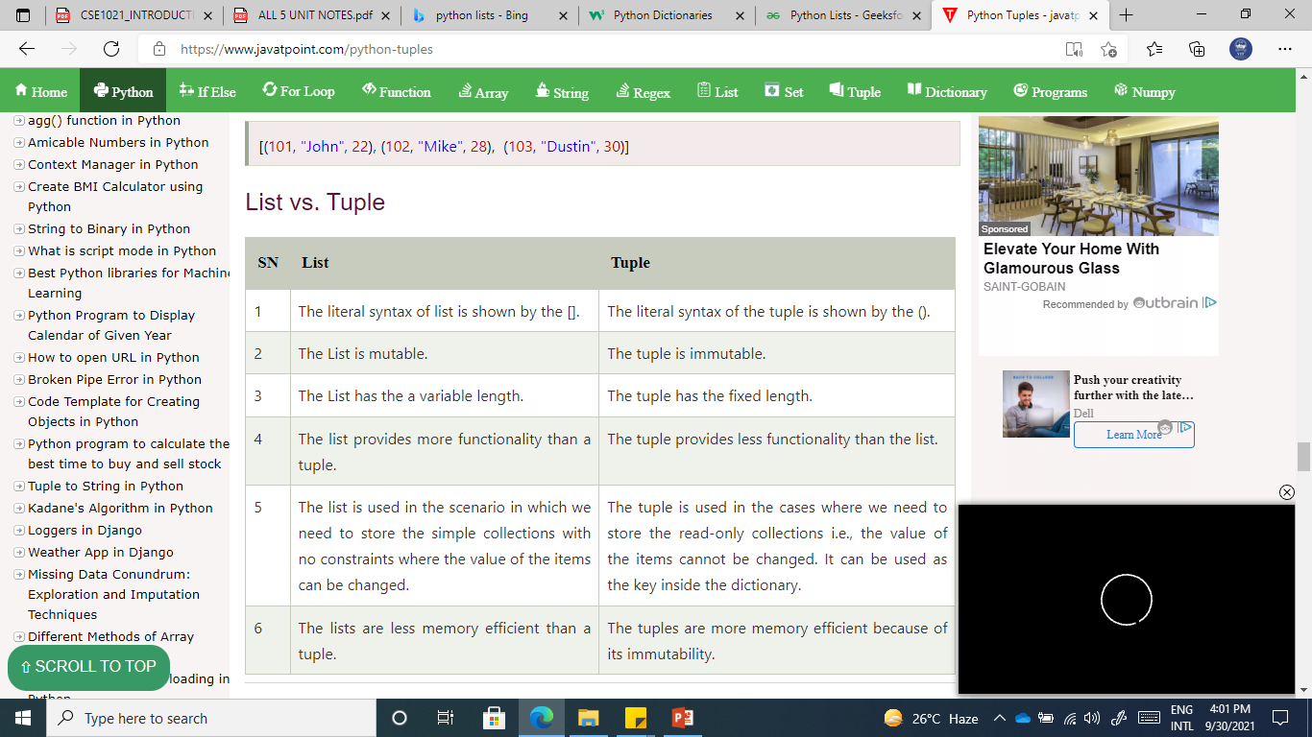

Slide 45
Mapping and Dictionaries
Unordered and Mutable data type
Dictionaries
Lists are ordered sets of objects, whereas dictionaries are unordered sets.
Dictionary is created by using curly brackets. i,e. {}
Dictionaries are accessed via keys and not via their position.
A dictionary is an associative array (also known as hashes). Any key of the dictionary is associated (or mapped) to a value.
The values of a dictionary can be any Python data type. So dictionaries are unordered key-value-pairs (The association of a key and a value is called a key-value pair )
Dictionaries don't support the sequence operation of the sequence data types like strings, tuples and lists.

Slide 46
DICTIONARIES
Operations
Indexing
Slicing
Creating a Dictionary
Live Examples …….

Slide 47
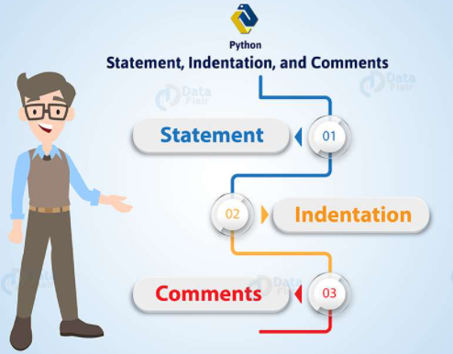
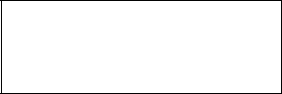
STATEMENTS AND EXPRESSIONS:
Statements:
Instructions that a Python interpreter can executes are called statements.
A statement is a unit of code like creating a variable or displaying a value.
n = 17
print(n)
Here, The first line is an assignment statement that gives a value to n.
The second line is a print statement that displays the value of n.

Slide 48

COMMENTS:
A hash sign (#) is the beginning of a comment.
Anything written after # in a line is ignored by interpreter.
Python does not have multiple-line commenting feature. You have to comment each line individually as follows :
Eg: # This is a comment.
# This is a comment, too.
# I said that already.
Eg: percentage = (minute * 100) / 60
# calculating percentage of an hour

Slide 49
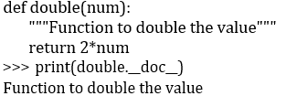
DOCSTRING
Docstring is short for documentation string.
Syntax:
functionname__doc.__
It is a string that occurs as the first statement in a module, function, class, or method definition. We must write what a function/class does in the docstring.
Triple quotes are used while writing docstrings.

Slide 50
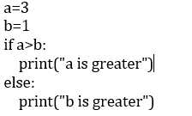
LINES AND INDENTATION
Most of the programming languages like C, C++, Java use braces { } to define a block of code. But, python uses indentation.
Blocks of code are denoted by line indentation.
It is a space given to the block of codes for class and function definitions or flow control.

Slide 51
TUPLE ASSIGNMENT
An assignment to all of the elements in a tuple using a single assignment statement.
Python has a very powerful tuple assignment feature that allows a tuple of variables on the left of an assignment to be assigned values from a tuple on the right of the assignment.
The left side is a tuple of variables; the right side is a tuple of values.
Each value is assigned to its respective variable.
All the expressions on the right side are evaluated before any of the assignments. This feature makes tuple assignment quite versatile.
Naturally, the number of variables on the left and the number of values on the right have to be the same.

Slide 52
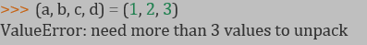
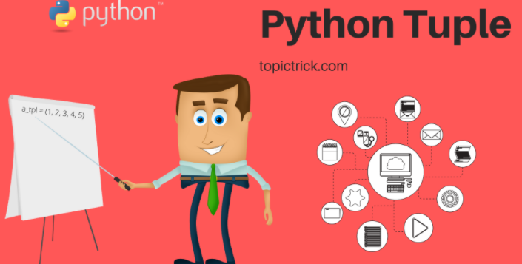
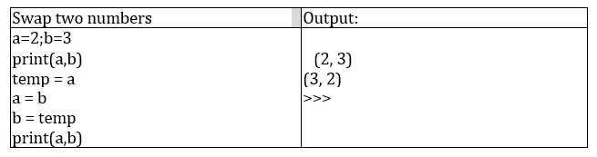
TUPLE ASSIGNMENT
Example:
It is useful to swap the values of two variables. With conventional assignment statements, we have to use a temporary variable. For example, to swap a and b:

Slide 53
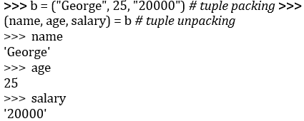
TUPLE ASSIGNMENT
Tuple assignment solves this problem neatly:
(a, b) = (b, a)
One way to think of tuple assignment is as tuple packing/unpacking.
In tuple packing, the values on the left are ‘packed’ together in a tuple:
>>> b = ("George", 25, "20000") # tuple
In tuple unpacking, the values in a tuple on the right are ‘unpacked’ into the variables/names on the right:

Slide 54
OPERATORS
Operators are the constructs which can manipulate the value of operands.
Consider the expression 4 + 5 = 9. Here, 4 and 5 are called operands and + is called operator
Types of Operators:
-Python language supports the following types of operators
Arithmetic Operators
Comparison (Relational) Operators
Assignment Operators
Logical Operators
Bitwise Operators
Membership Operators
Identity Operators

Slide 55
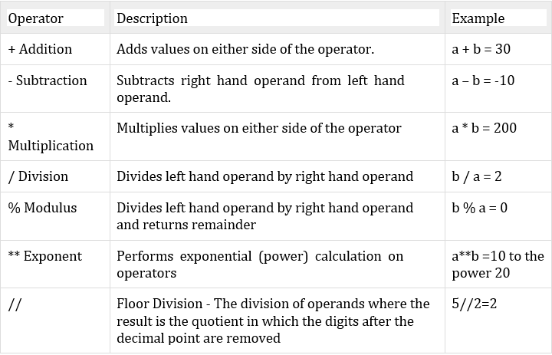
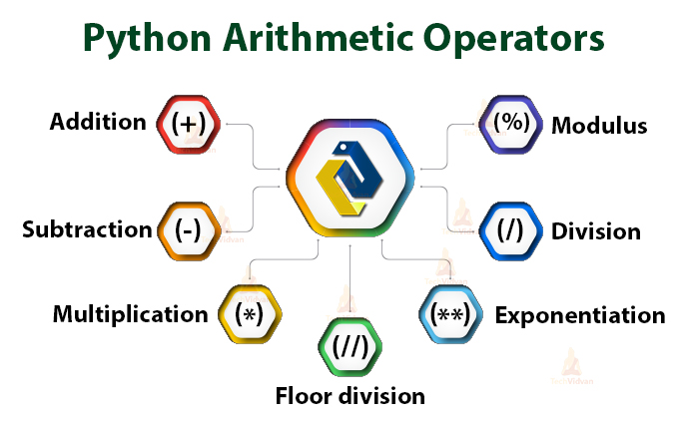
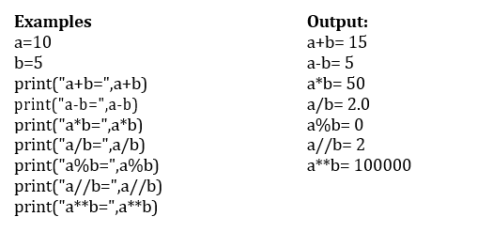
Arithmetic operators
They are used to perform mathematical operations like addition, subtraction, multiplication etc. Assume, a=10 and b=5

Slide 56
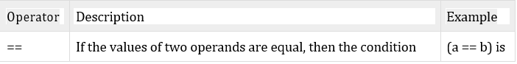
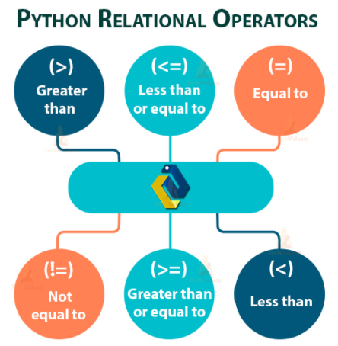
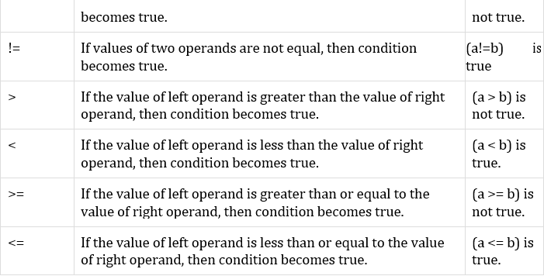
Comparison (Relational) Operators:
Comparison operators are used to compare values.
It either returns True or False according to the condition. Assume, a=10 and b=5

Slide 57
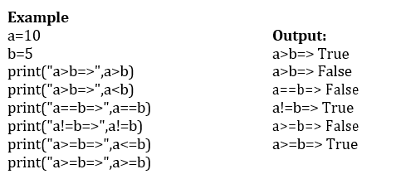
Comparison (Relational) Operators:
Comparison operators are used to compare values.
It either returns True or False according to the condition. Assume, a=10 and b=5

Slide 58
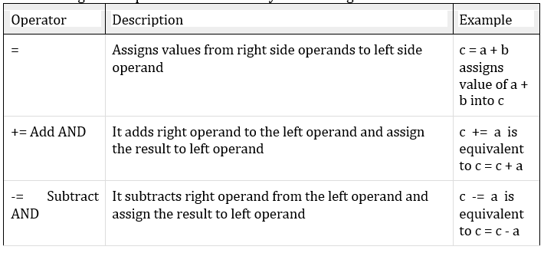
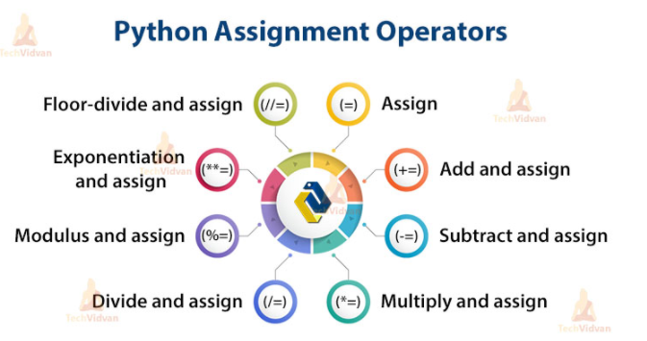
Assignment Operators
Assignment operators are used in Python to assign values to variables.

Slide 59
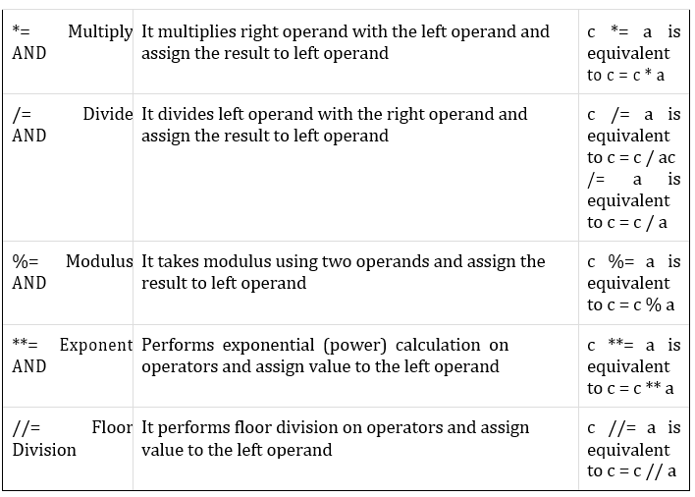
Assignment Operators

Slide 60
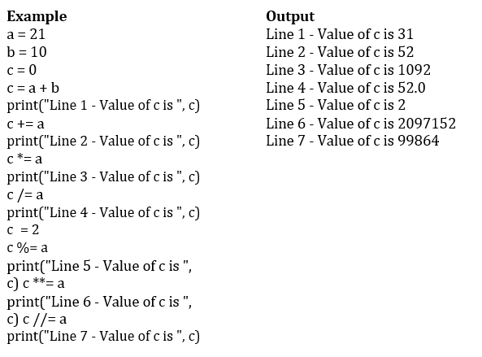
Assignment Operators

Slide 61
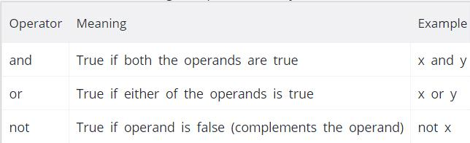
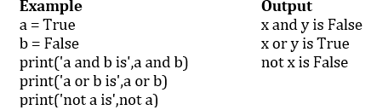
Logical Operators
Logical operators are the and, or, not operators.

Slide 62
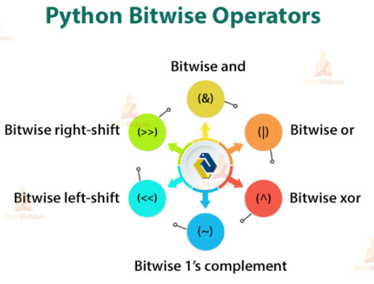
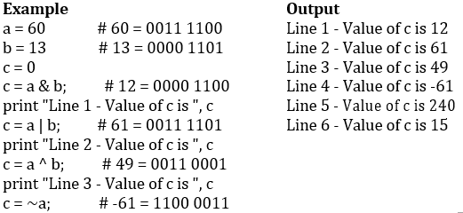
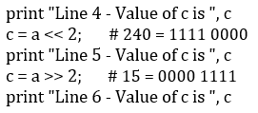
Bitwise Operators:
A bitwise operation operates on one or more bit patterns at the level of individual bits

Slide 63
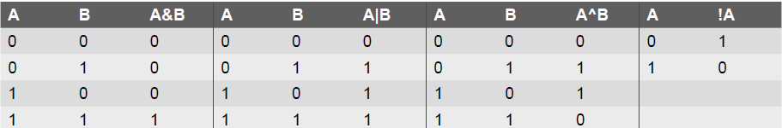
Bitwise Operators
As the name suggests, bitwise operators perform operations at the bit level. These operators include bitwise AND, bitwise OR, bitwise XOR, and shift operators. Bitwise operators expect their operands to be of integers and treat them as a sequence of bits.
The truth tables of these bitwise operators are given below.
© Oxford University Press 2017. All rights reserved.

Slide 64
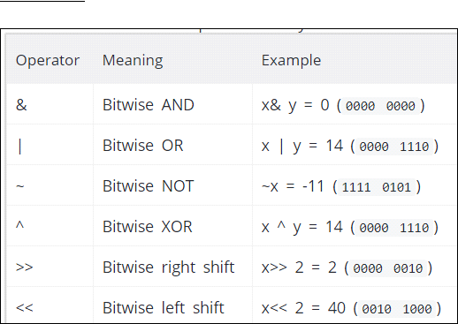
Bitwise Operators:
A bitwise operation operates on one or more bit patterns at the level of individual bits
Example: Let x = 10 (0000 1010 in binary) and y = 4 (0000 0100 in binary)

Slide 65
Shift Operators
Python supports two bitwise shift operators. They are shift left (<<) and shift right (>>). These operations are used to shift bits to the left or to the right. The syntax for a shift operation can be given as follows:
Examples:
© Oxford University Press 2017. All rights reserved.

Slide 66
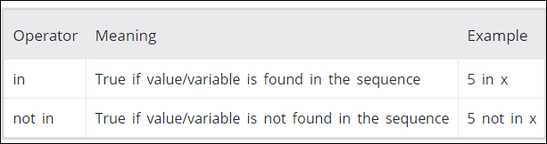
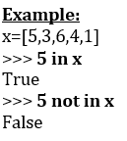
Membership Operators
Evaluates to find a value or a variable is in the specified sequence of string, list, tuple, dictionary or not.
Let, x=[5,3,6,4,1]. To check particular item in list or not, in and not in operators are used.

Slide 67
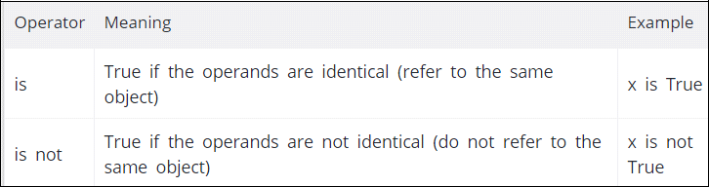
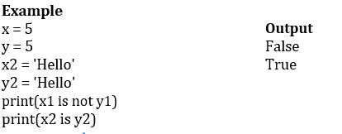
Identity Operators
They are used to check if two values (or variables) are located on the same part of the memory

Slide 68

Expressions- Operator Precedence

Slide 69


